Slide 1
ECG spectrogram scalogram

Slide 2
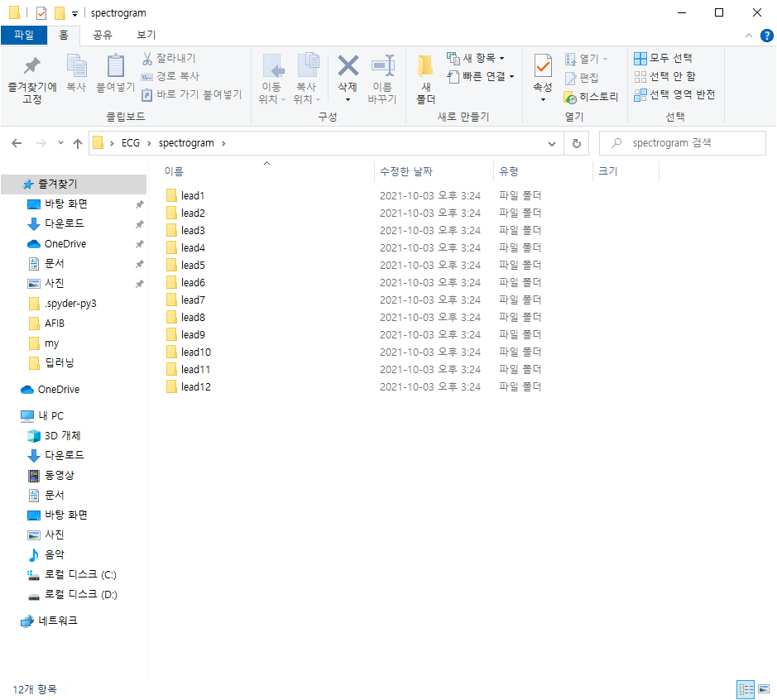
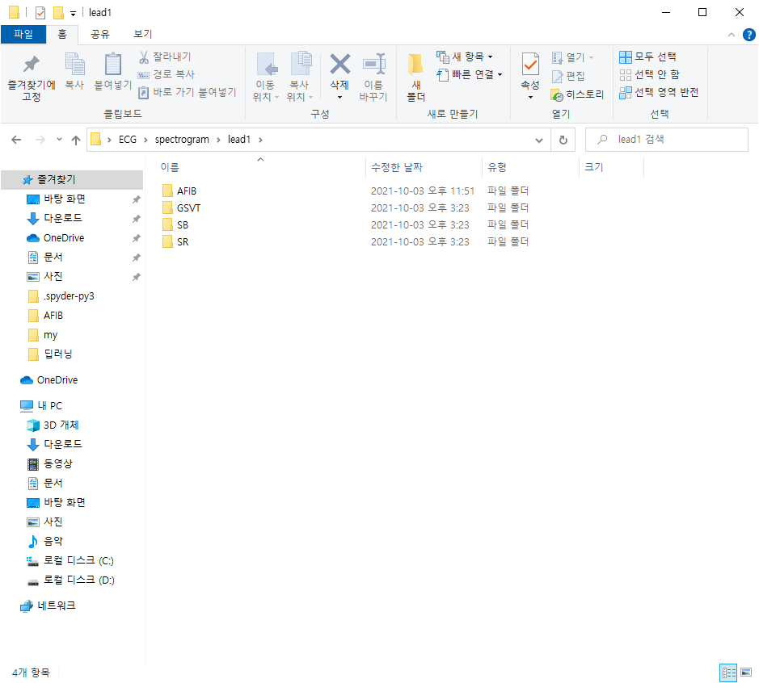
Spectrogram에 폴더 생성

Slide 3


Scalogram에 폴더 생성

Slide 4
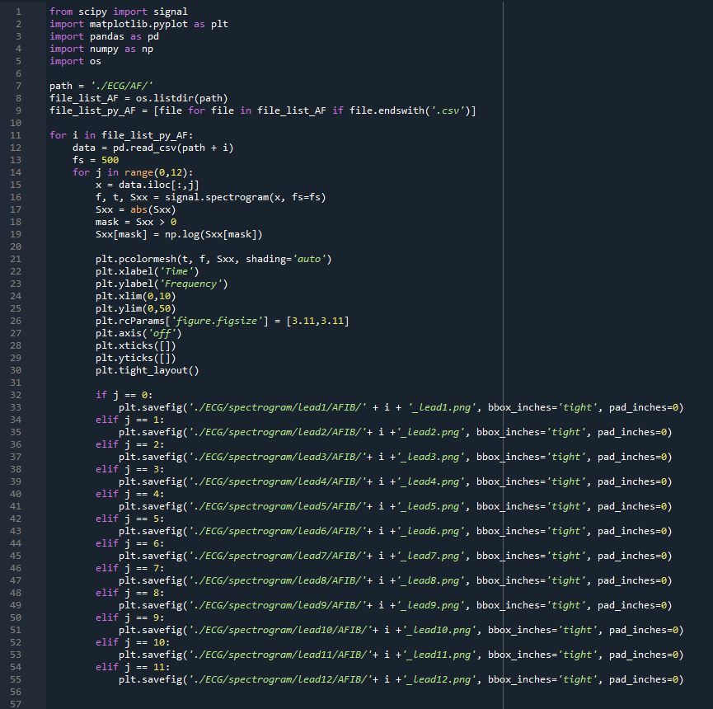
ECG spectrogram code

Slide 5
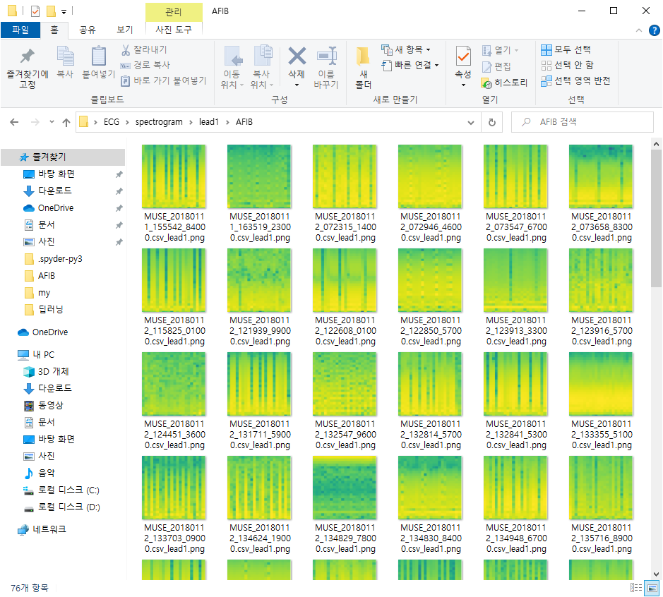
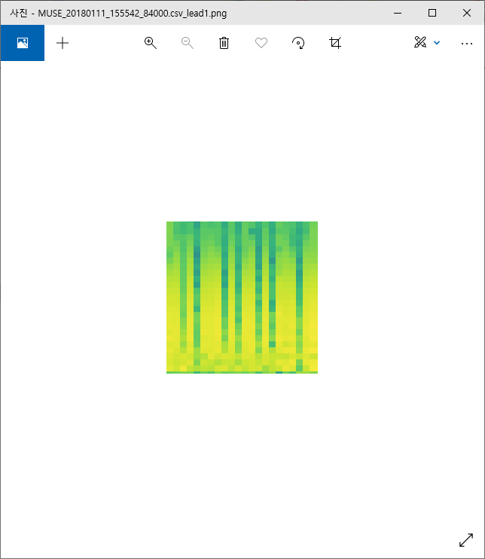
Spectrogram

Slide 6
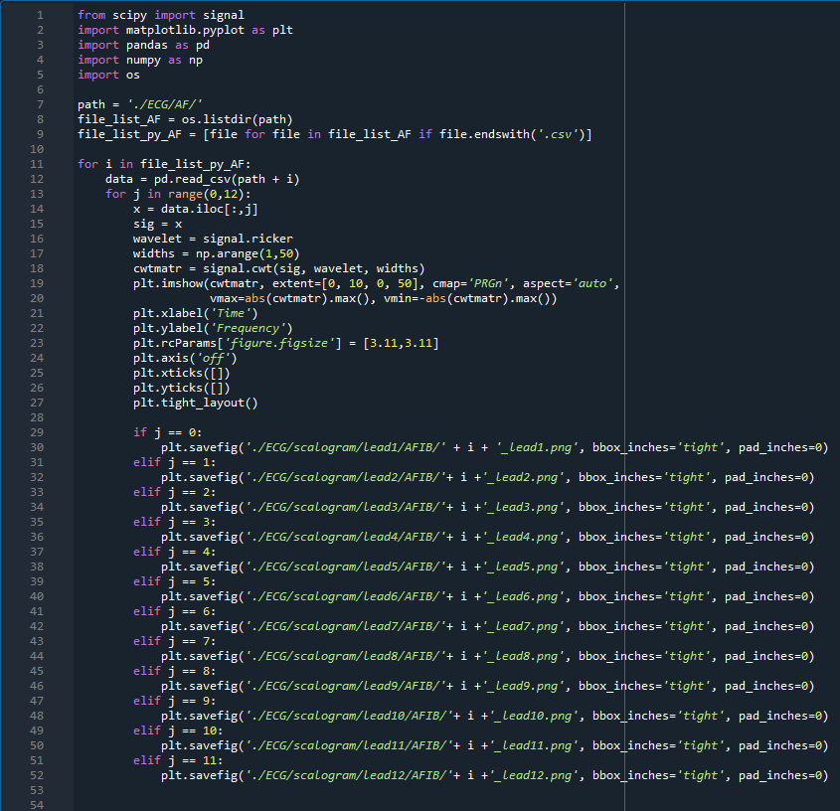
ECG scalogram code

Slide 7
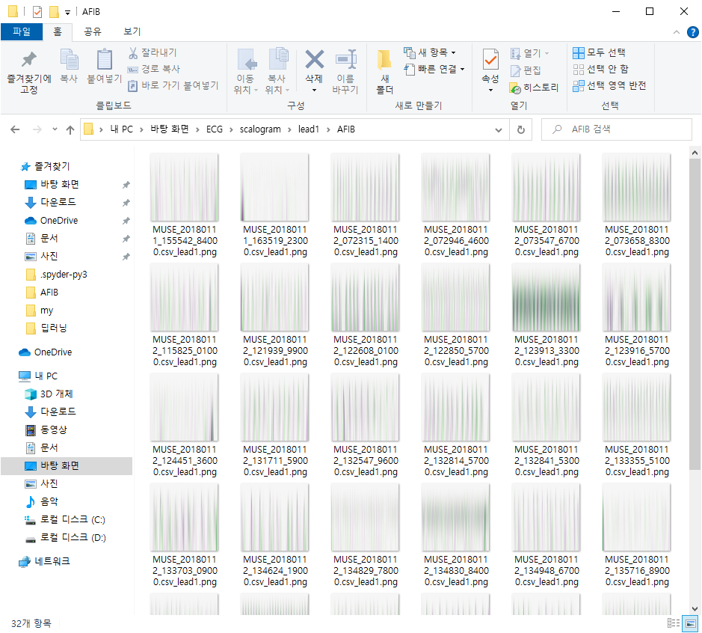
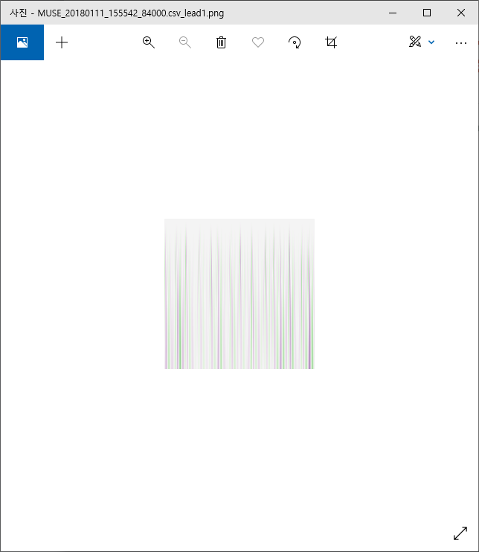
Scalogram

Slide 8
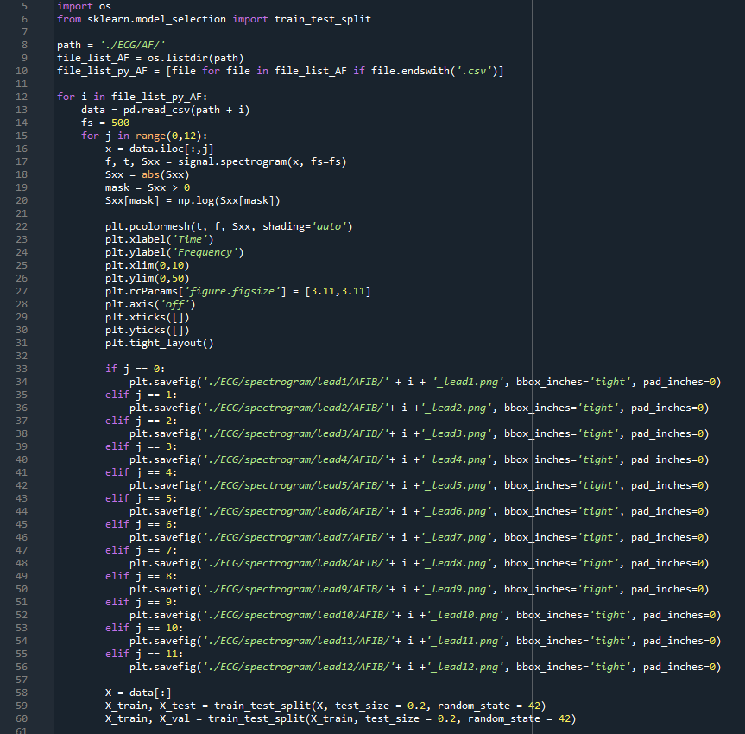
Train,Test,Validation
Train 64%, val 16%, test 20%

Slide 9
감사합니다

